Slide 1
Security Hardening – Case Study – Oracle
Oracle Database 12c
DISA, Release 18
28 April 2017

Slide 2
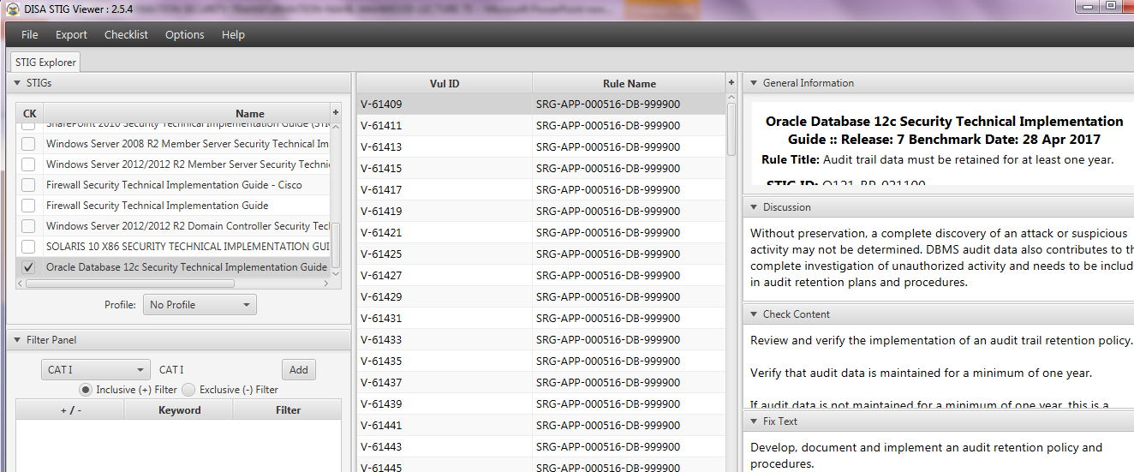
Security Hardening – Case Study – Oracle
STIGVIEWER WINDOW

Slide 3
Security Hardening – Case Study – Oracle
General Information:
Rule Title: The Oracle Listener must be configured to require administration authentication
STIG ID: O121-BP-022700
Severity: CAT I

Slide 4
Security Hardening – Case Study – Oracle
Discussion:
Oracle listener authentication helps prevent unauthorized administration of the Oracle listener. Unauthorized administration of the listener could lead to DoS exploits;

Slide 5
Security Hardening – Case Study – Oracle
Discussion…:
…loss of connection audit data, unauthorized reconfiguration or other unauthorized access. This is a Category I finding because privileged access to the listener is not restricted to authorized users.

Slide 6
Security Hardening – Case Study – Oracle
Discussion…:
…Unauthorized access can result in stopping of the listener (DoS) and overwriting of listener audit logs.

Slide 7
Security Hardening – Case Study – Oracle
Check Content:
If a listener is not running on the local database host server, this check is not a finding

Slide 8
Security Hardening – Case Study – Oracle
…Check Content:
For Windows hosts, view all Windows services with TNSListener embedded in the service name
The service name format is: Oracle[ORACLE_HOME_NAME]TNSListener

Slide 9
Security Hardening – Case Study – Oracle
…Check Content:
View the STIGVIEWER for Unix hosts…

Slide 10
Security Hardening – Case Study – Oracle
Fix Text:
By default, Oracle Net Listener permits only local administration for security reasons. As a policy, the listener can be administered only by the user who started it. This is enforced through local operating system authentication.

Slide 11
Security Hardening – Case Study – Oracle
Fix Text:
For example, if user1 starts the listener, then only user1 can administer it. Any other user trying to administer the listener gets an error. The super user is the only exception.

Slide 12
Security Hardening – Case Study – Oracle
Fix Text:
Remote administ. of the listener must not be permitted. If listener administ. from a remote system is required, granting secure remote access to the Oracle DBMS server and performing local administration is preferred.

Slide 13
Security Hardening – Case Study – Oracle
CCI (Control Correlation Identifier):
CCI: CCI-000366 The organization implements the security configuration settings.

Slide 14
Security Hardening – Case Study – Oracle
…CCI (Control Correlation Identifier):
…NIST SP 800-53 :: CM-6 b NIST SP 800-53A :: CM-6.1 (iv) NIST SP 800-53 Revision 4 :: CM-6 b
END

